Slide 1
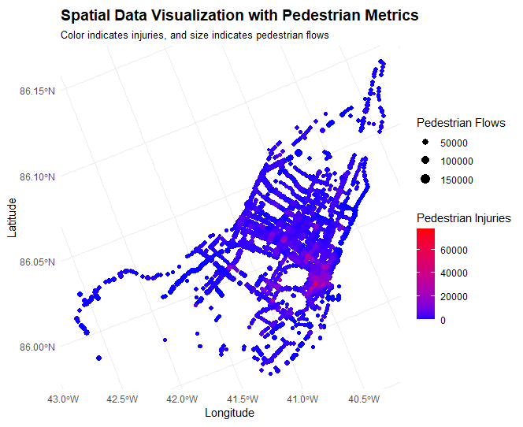
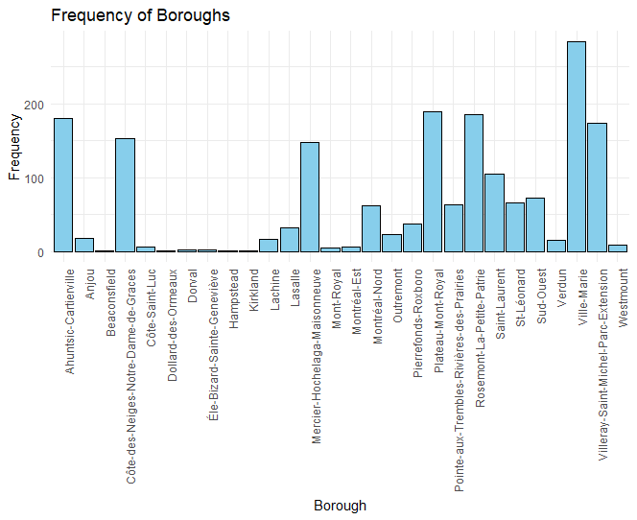
Spatial overview of accidents
Most dangerous accidents are highly concentrated near downtown area, you can see that certain boroughs are generally more dangerous than others which leads to conclusion that spatial structure and road structure types does play a role in high accident rates. Number of accidents are impacted by traffic flow but we tried to identify most dangerous intersections attending to other important factors as well

Slide 2
Intersections Metrics to consider
Metrics Increasing accidents
Metrics Decreasing accidents
Legend :
1 : very important
2 : medium importance
3 : low importance
* : tests not very conclusive
Factor | Importance
number of entrances/exits to commercial properties | 1
sum of the road widths (outside crosswalks) along each approach of the intersection | 1
parking on one side of the street | 1
borough | 2
six lanes flowing into the intersection along all approaches | 3
presence of green-straight arrow | 3*
Factor | Importance
median | 1
presence of a restricted left turn lane at the intersection | 1
parking on both sides on the street | 2
presence of a semi-protected pedestrian phase | 2
difference between crosswalk length at the intersection and road width 15 meters away from the intersection | 2
These factors will help you understand which modifications to take into considerations when trying to improve the safety of intersections. Depending on the city budget, we would suggest to tackle the high importance metrics first as they will help reduce the number of accidents by a greater margin than lower metrics
As a general rule, we recommend parking on both side of the streets rather than 1, less wide roads, not too many commercial entrances near intersections and safety measures like median and a restricted left turn lane will help reduce accidents significantly

Slide 3
Most dangerous intersections and their characteristics
Rank | ID’s | Median | Parking sides | Restricted left | Pedestrian phase | Crosswalk vs intersection length | Commercial property entrances | Sum of Road width | Green arrow | 6 lanes
#1 | 906 | YES | 0 | YES | NO | 0 | 2 | 75.2 | YES | YES
#2 | 633 | NO | 1 | YES | NO | 0 | 0 | 49.2 | YES | NO
#3 | 6736 | YES | 0 | NO | NO | 0 | 4 | 79.9 | NO | YES
#4 | 481 | NO | 0 | YES | NO | 0 | 0 | 64.1 | YES | NO
#5 | 1249 | YES | 0 | YES | NO | 0 | 4 | 107.1 | YES | NO
#6 | 601 | NO | 1 | YES | NO | 0 | 0 | 53.9 | YES | YES
#7 | 8256 | YES | 0 | YES | YES | 0 | 0 | 86.1 | YES | YES
#8 | 931 | YES | 0 | NO | NO | 0 | 0 | 90.0 | YES | YES
#9 | 444 | YES | 1 | YES | YES | 0 | 0 | 82.5 | YES | YES
#10 | 1092 | NO | 1 | YES | NO | 0 | 0 | 71.5 | YES | NO
This chart shows which intersections are the most dangerous . Based not only on actual accident counts but on our statistical models, we were able to predict dangerousness. We categorized these dangerous intersections based on the most important features in previous slide to show where potential city work and adjustment can be made on them.
We recommend focusing on the missing decreasing metrics and implement them and maybe try to bring changes to increasing metrics as well

